Slide 1
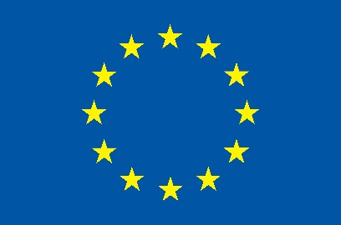
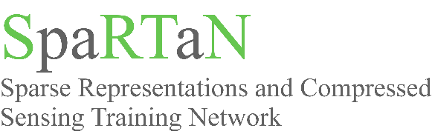


Making do with less (data):
Compressed Sensing in MRI
Ian Marshall
Centre for Clinical Brain Sciences
University of Edinburgh

Slide 2
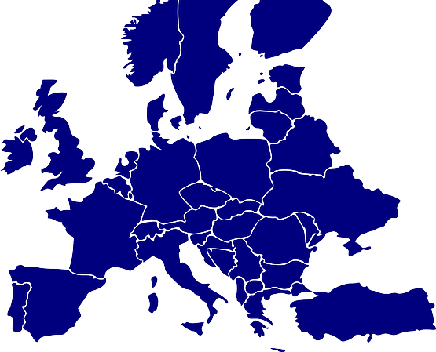
Partners
Beneficiaries (Full Partners)
(Associate) Partners
Noiseless Imaging (FI)
CEDAR (UK)
TUT (FI)
A Analytic (UK)
UEdin (UK)
Songquito (DE)
Surrey* (UK)
GE (DE)
Fraunhofer (DE)
EPFL* (CH)
INRIA (FR)
VisioSafe* (CH)
TUM (DE)
Bioiatriki (GR)
IT (PT)
CTI (GR)

Slide 3
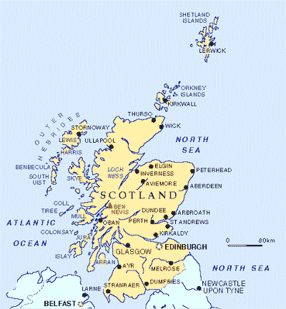

Slide 4
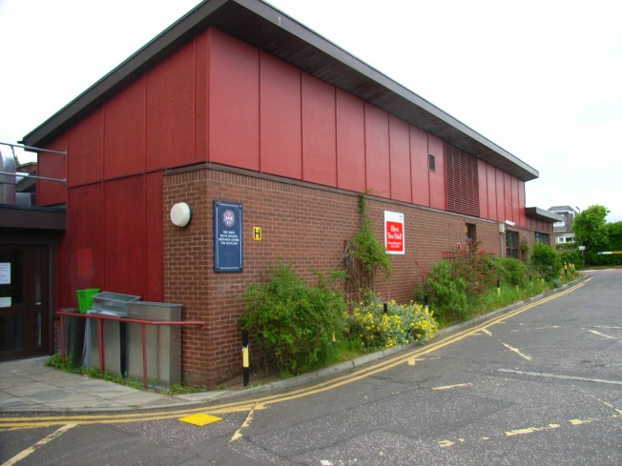
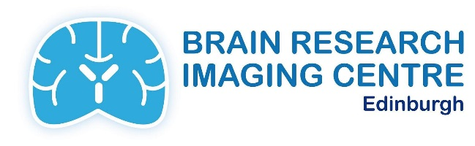
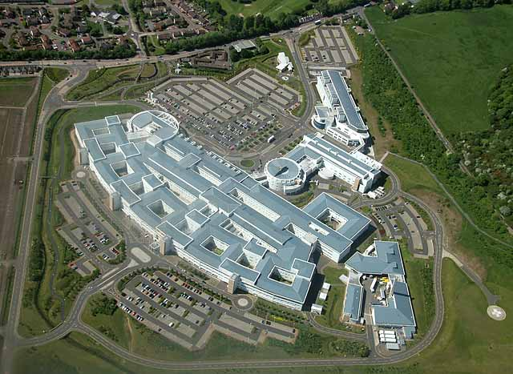

Slide 5
Outline
Data acquisition in MRI
Undersampling
CS applied to MRI
Practical issues
Applications

Slide 6
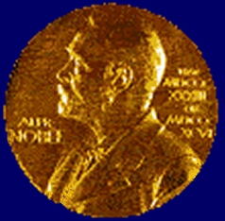
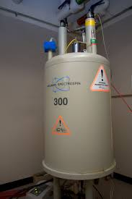
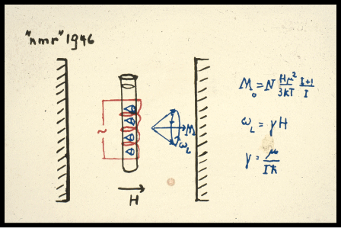
Nuclear Magnetic Resonance
Rabi 1938 Physics 1944
Bloch 1946 and Purcell 1946 Physics 1952

Slide 7
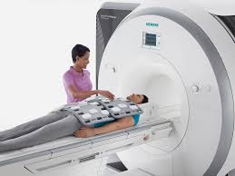
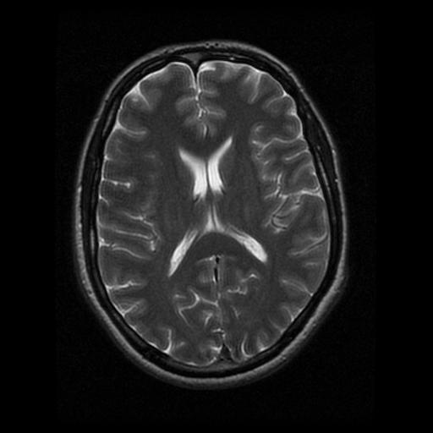
Spatial localisation
Imaging (MRI)
Lauterbur 1973 and Mansfield 1973
Medicine 2003

Slide 8
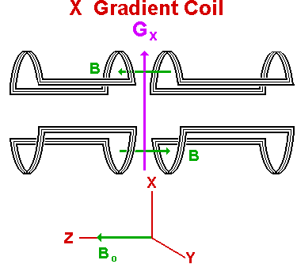
Main magnetic field is modulated by pulsed gradient fields

Slide 9
MRI acquisition
Excite
Evolve
Acquire

Slide 10
MRI acquisition
repeat
Excite
Evolve
Acquire
until spatially encoded

Slide 11
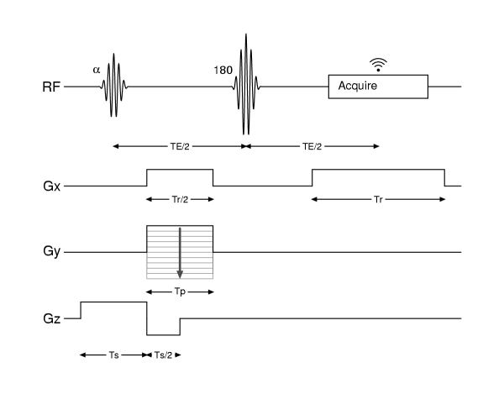
MRI acquisition
TR

Slide 12
Phase (k_{y})
phase (k_{y})
Readout (k_{x})
k-space

Slide 13
FT
k-space image space

Slide 14
http://www.eecs.berkeley.edu/~mlustig/

Slide 15
FT
k-space image space

Slide 16
FT
k-space image space

Slide 17
FT
k-space image space

Slide 18
FT
k-space image space

Slide 21
Is there a better way?

Slide 22
Is there a better way?
Most images are ‘sparse’
Data compression (RAW JPEG)

Slide 23
Is there a better way?
Most images are ‘sparse’
Data compression (RAW JPEG)
If you don’t need the data,
why collect it?

Slide 24
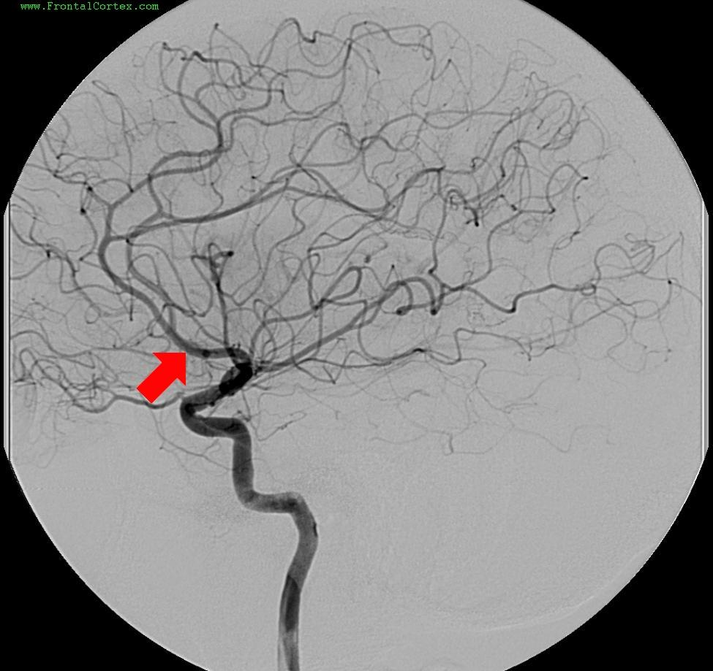
FrontalCortex.com

Slide 25
Wavelet transform
T2w brain image
http://www.eecs.berkeley.edu/~mlustig/CS.html

Slide 26
Original 10% wavelet coeffs difference

Slide 27
Compressed Sensing
Candes 2006, Donoho 2006
IEEE Trans Inf Theory
Lustig Magn Reson Med 2007
Notes:
Candes (Caltech) 4000+ citations; Donoho (Stanford) 6000+ citations; Lustig (Stanford) 1300

Slide 28
Compressed Sensing
Candes 2006, Donoho 2006
IEEE Trans Inf Theory
Lustig Magn Reson Med 2007
Sparsity
Randomly undersampled data
Nonlinear reconstruction
Notes:
Candes (Caltech) 4000+ citations; Donoho (Stanford) 6000+ citations; Lustig (Stanford) 1300

Slide 29
http://www.eecs.berkeley.edu/~mlustig/
X FX UXF

Slide 30
http://www.eecs.berkeley.edu/~mlustig/
X FX UXF

Slide 31
http://www.eecs.berkeley.edu/~mlustig/
X FX UXF

Slide 32
Y = U F X

Slide 33
Y = U F X
||Y - U F X||² < ε (Least Squares)

Slide 34
Y = U F X
||Y - U F X||² < ε (Least Squares)

Slide 35
Compressed Sensing
Minimise ||Q X||₁ (sparsity)
subject to…
||Y - U F X||² < ε (data consistency)

Slide 36
“…the results are surprising” (Candes 2006)

Slide 37
Minimise the objective function…
{ ||W X||₁ + λ ||Y - U F X||²}
Iterative solution

Slide 38
3 times undersampling mask

Slide 39
Original Linear recon difference

Slide 40
Linear recon CS recon
http://www.eecs.berkeley.edu/~mlustig/CS.html

Slide 41
F
W
Threshold
Enforce sparsity in W-domain
W⁻¹
F⁻¹
Insert
measured data
Data consistency in k-space
F

Slide 42
But…
Can’t undersample in k_{x}
1D undersampling doesn’t work well
2D undersampling pattern is critical
SNR?

Slide 43
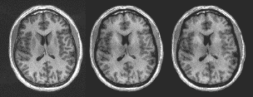
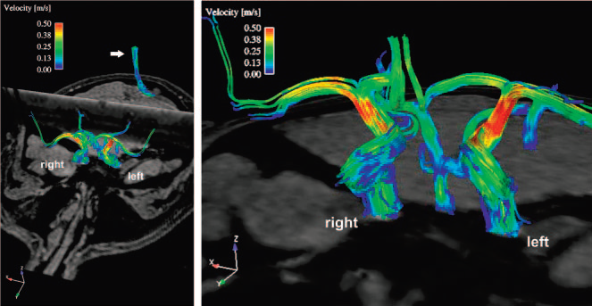
FULL
×4CS
×6CS
Applications
Need to undersample
in 2 or more dimensions
Standard 2D Brain -
3D brain +
Multiparameter 2D brain +
Cardiac +
Blood flow +

Slide 44
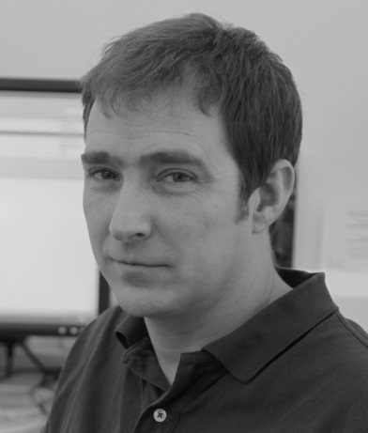
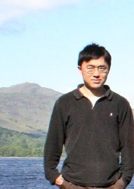
Mike Davies, IDCOM, Engineering
Communications
Radar
Sparsity
Algorithms
EPSRC Davies & Marshall 2008-2011
Yuehui Tao
‘Terry’

Slide 45
Carotid blood flow

Slide 46
kt -space
Fully sampled
Undersampled

Slide 47
Tao et al, Magn Reson Imag 2013

Slide 48
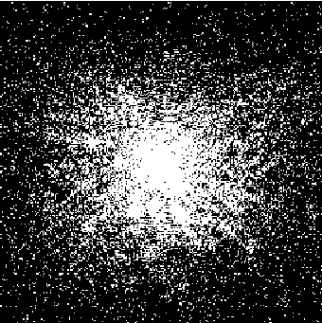
undersampling of 3D brain images
Undersample in BOTH
phase encode directions
6 healthy volunteers
Full, 4× and 6× undersampling
LMS and CS recon
Brain volumes (WM, GM, CSF)
Radiological assessment

Slide 51
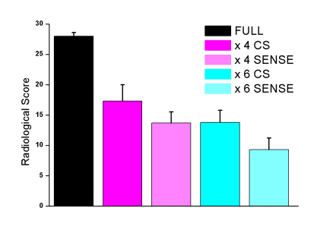
undersampled 3D brain images
FULL
×4CS
×6CS
ISMRM 2015, #2497

Slide 52
Current work
Compressed Sensing to accelerate MRI
MR Fingerprinting (+ CS) for qMRI
3 PostDocs, 3 PhD students

Slide 53
Quantitative MRI
TR, TE, flip angle
TR

Slide 54
Proton Density
T2w
T1w (often volumetric)
GRE (T2*)
FLAIR
Diffusion imaging
Spectroscopy

Slide 55
slightly
nearly
IAN
http://www.eecs.berkeley.edu/~mlustig/

Slide 56

Acknowledgements
CCBS
Dominic Job
Andrew Farrall
Yuehui Tao (‘Terry’)
Samarth Varma
Joanna Wardlaw
Research Radiographers
Engineering
Mike Davies
Gabriel Rilling
Chaoran Du
Arnold Benjamin
Wajiha Bano

Slide 57
